Slide 1
Project 1: Sales Predictions
Amanda Benjamin
Due: 04/01/2022

Slide 2
Agenda
01. Introduction
02. Problem
03. Explore the data
04. Machine Learning
05. Summary

Slide 3

Introduction
Intro to data science project
Sales prediction for food items sold at various stores

Slide 4

Problem: Need to help the retailer understand the properties of products and outlets that play crucial roles in increasing sales.

Slide 5
Data Dictionary
Variable Name | Description
Item_Identifier | Unique product ID
Item_Weight | Weight of the product
Item_Fat_content | Whether the product is low fat or regular
Item_Visibility | % of total display area of all products in a store allocated to the product
Item_Type | The category to which the product belongs
Item_MRP | Maximum Retail Price (list price) of the product
Outlet_Identifier | Unique store ID
Outlet_Establishment_Year | The year in which the store was established
Outlet_Size | The size of the store in terms of ground area covered
Outlet_Location_Type | The type of area in which the store is located
Outlet_Type | Whether the outlet is a grocery store or some sort of supermarket
Item_Outlet_Sales | Sales of the product in the particular store

Slide 6
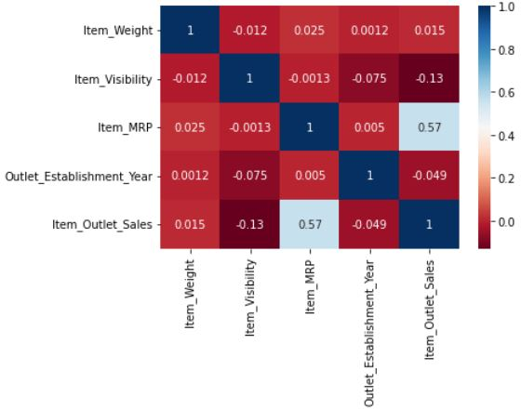
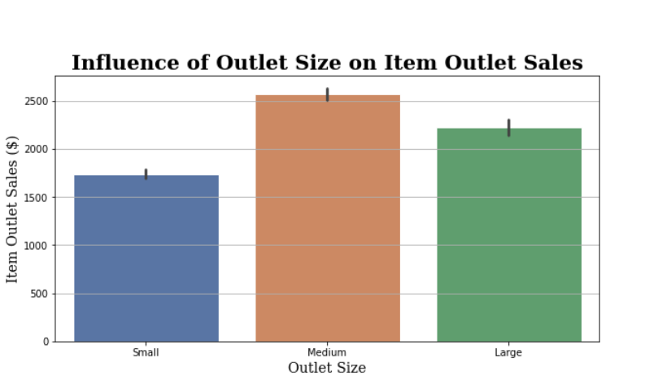
Data Visualizations
Item Retail price has a moderately strong correlation with Item outlet sales
Mid-sized outlets have the highest item outlet sales

Slide 7
Data Visualizations
Item retail price has a moderately strong correlation with Item outlet sales

Slide 8
Data Visualizations
Mid-sized outlets have the highest item outlet sales

Slide 9
Machine Learning
Linear Regression
Regression Tree Model
R² train: 0.56
RMSE train: 1140.4
R² t test: 0.56
RMSE test: 1094.5
R² train: 0.62
RMSE train: 1067.3
R² t test: 0.58
RMSE test: 1073.1

Slide 10
Recommendations:
Increase Item MRP
Invest in more mid-sized outlets in the communities

Slide 11
Summary
Opportunity to showcase data science skills
Regression tree model best predictor
Data clean up, visualizations, and machine learning
Stronger correlation of determination (R²)
Lower variance (RMSE)
Food sales prediction project
Recommendations
Help the retailer understand the properties of products and outlets that play crucial roles in increasing sales.
Increase Item MRP
Impact of Item MRP + Outlet Size
Increase in Item MRP tends to increase I.O.S
Mid-size outlets shown to have higher I.O.S compared to large and small sized outlets

Slide 12

Thank you

